Slide 1

Hospitality Performance Analysis Project
The Team:
Rehan
Gulfam
Ashalata
Adarsha
Divya
Soujanya
Group 1 Final Presentation dated: 5th July 2025

Slide 2




Brief overview of objectives and impact
Time Period Analyzed: May 2022 to July 2022 (92 days)
Data Sources:
fact_bookings – Booking data with status (Checked Out, Cancelled, No Show)
fact_agg_booking – Room capacity data
dim_date – Calendar for trend analysis
Total Bookings Analyzed: 134.59K reservations
Key Focus Areas:
Booking behavior and patterns
Cancellation and No Show trends
Capacity utilization across months
Revenue and Occupied % by Month

Slide 3

Tools Used:
Excel – For initial exploration and pivot tables
SQL – To transform and filter booking and date data
Tableau – For class-wise and segment-level visualization
Power BI – For KPI dashboard and advanced trend analysis
Impact of Analysis:
Identified July as the month with highest cancellation %
Utilized Capacity across 3 months: ~40.59%
Low No Show Rate: 5.02%
Helped uncover stable revenue despite varying occupancy

Slide 4
Key performance indicators
Total Bookings: 134.59K Measures overall customer interest and total business volume generated.
Utilized Capacity %: 40.59% Evaluates how efficiently the available room inventory is being used.
Cancellation %: 24.83% Tracks revenue leakage and customer unreliability due to last-minute cancellations.
No Show Rate %: 5.02% Indicates bookings where guests neither canceled nor checked in — affecting occupancy planning.
Total Checked Out: 94K Reflects actual room utilization and successful guest stays.
Revenue by Month: May - 582M, June – 554M , July - 573M Helps monitor income trends and identify peak or off-season periods.
Occupied % by Month: May – 40.88%, June – 40.54% , July – 40.35% Useful for monthly performance comparison and resource allocation optimization.

Slide 5
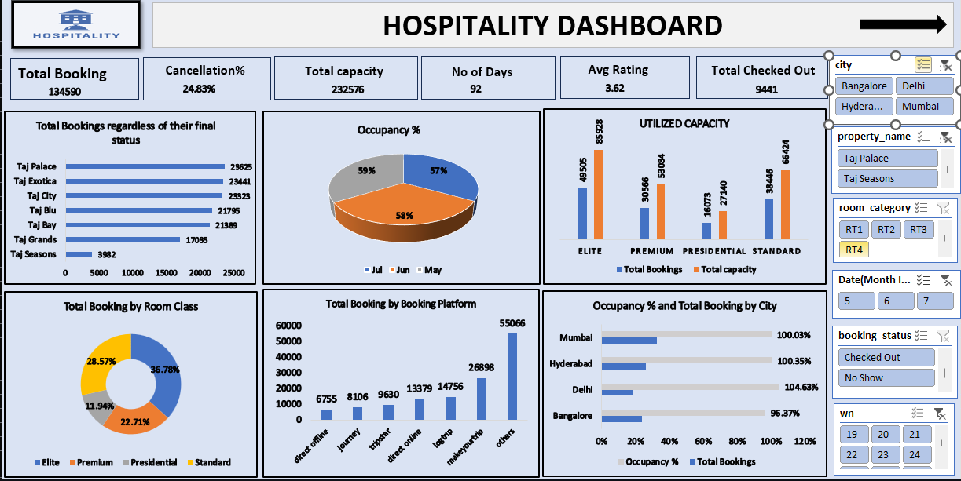
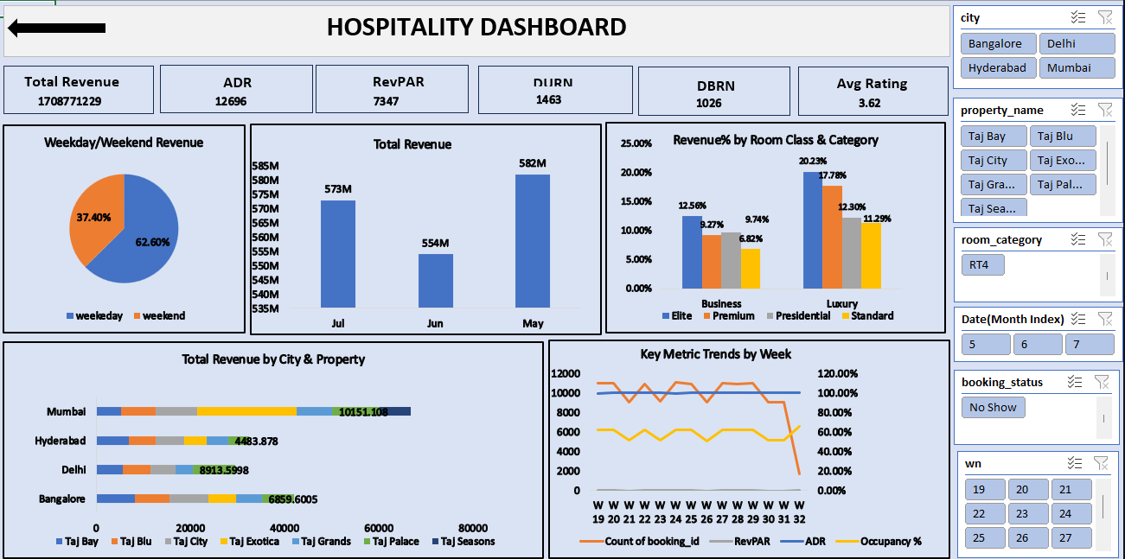
Excel Dashboard – Initial findings and data trends.
Initial findings and data trends were explored using pivot tables and filters.
Key areas included:
- Booking status distribution
- Cancellation vs. Checked Out ratio
- Revenue by region or room type
- Date range verification

Slide 6
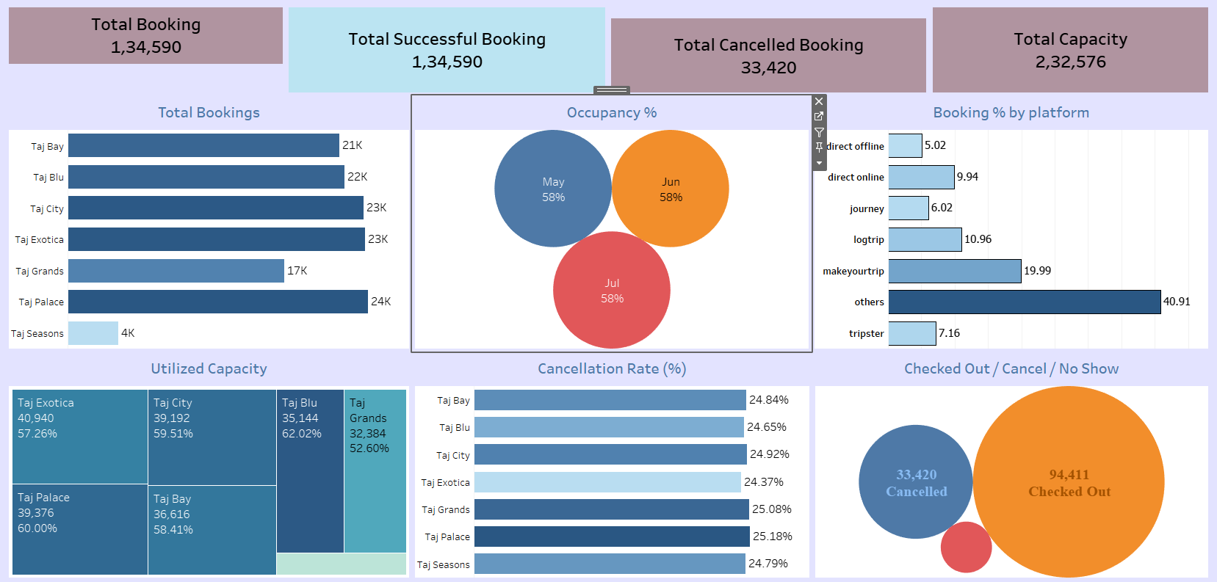
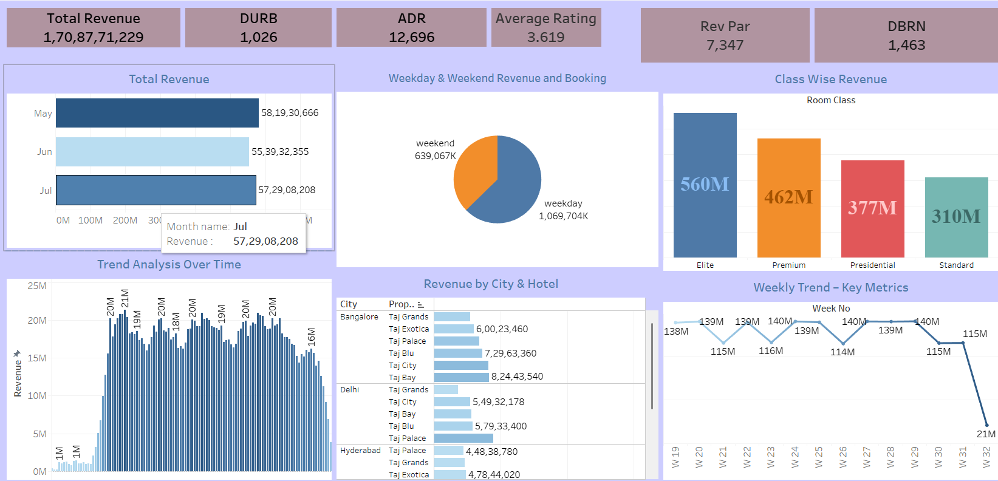
Tableau Dashboard – Interactive visualizations and insights.
Used for interactive visualizations and deep-dives into:
- Revenue segmented by room category
- Class-wise revenue analysis
- Weekly trends and booking behavior
- Status-based filtering for cancellations, no-shows, checkouts

Slide 7
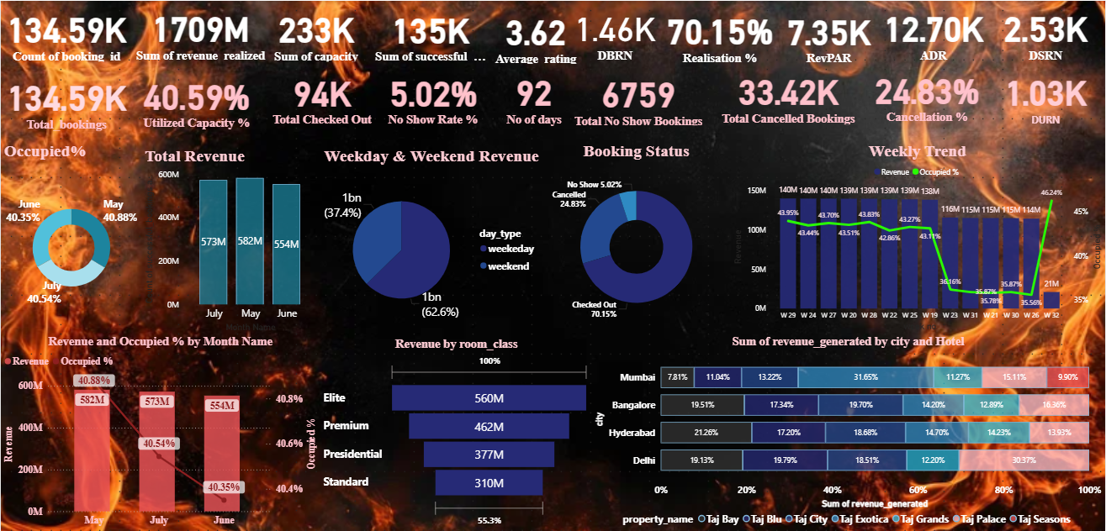
Power BI Dashboard – Advanced analytics and performance tracking.
Developed for advanced analytics and KPI monitoring:
- Total bookings, cancellation %, no-show rate, etc.
- Utilized capacity % and revenue trends
- Trend Analysis: Revenue and Occupied % over time
- Clean layout with dynamic cards and visual KPIs

Slide 8
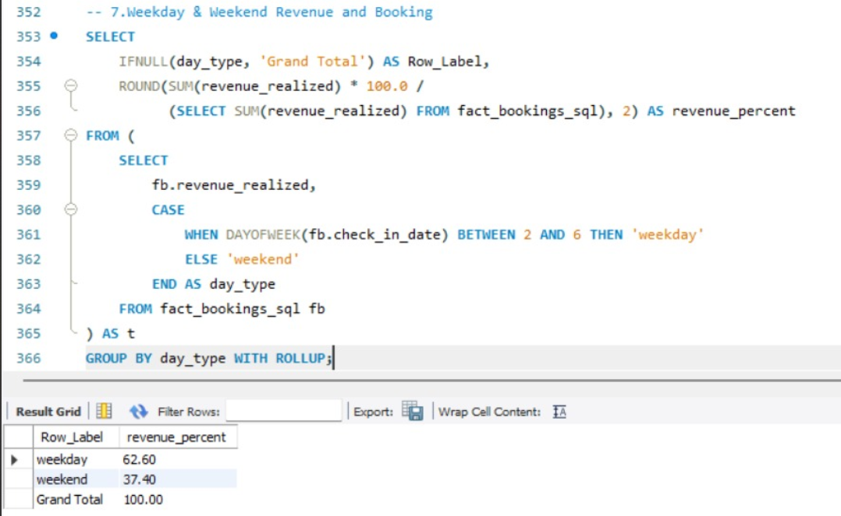
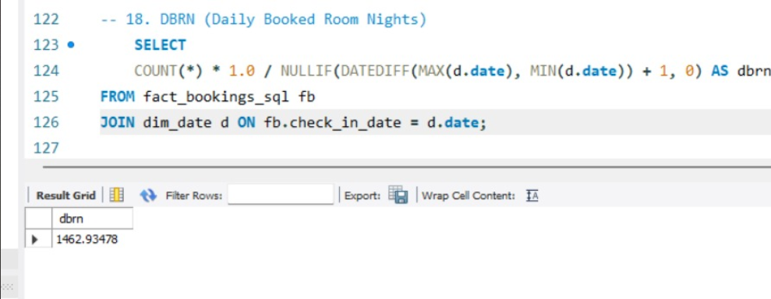
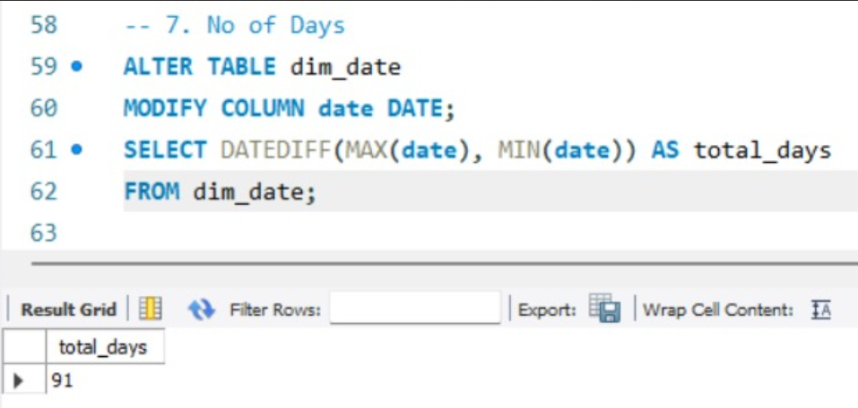
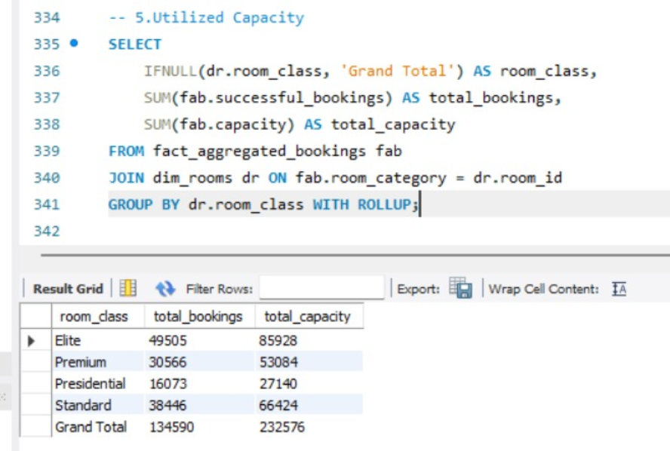
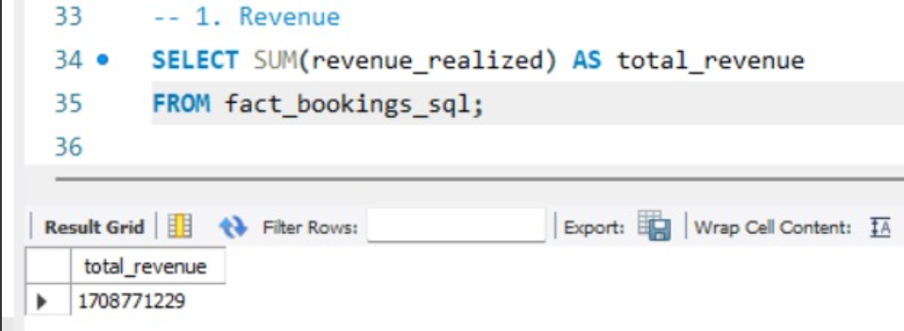
SQL Query Image – Schema and queries used for data transformation.

Slide 9





Key Takeaways
Business Insights:
Total bookings of 134.59K reflect strong customer interest.
Utilized capacity consistently around 40.5%, indicating underutilization.
Revenue was highest in May (₹582M), but remained steady across all 3 months.
Cancellation Rate (24.83%) and No-Show Rate (5.02%) are notable operational risks.
Checked Out guests (94K) reflect a majority of successful bookings.
Challenges Identified:
High cancellation and no-show rates affecting revenue realization.
Limited occupancy despite high bookings suggests gaps in conversion or overbooking.
No show and cancellations lead to underutilization of inventory.
Future Recommendations:
Introduce flexible pricing or early bird discounts to reduce cancellations.
Deploy automated reminders or penalties to reduce no-shows.
Analyze customer behavior for better forecasting and inventory planning.
Optimize marketing strategies for off-peak months like June.

